Slide 1
http://www.ans.org/
http://local.ans.org/ne/

Slide 2
Introduction to Electrical Power Generation
Presented by: Robert Kalantari
To Burlington High School
October 10, 2019

Slide 3
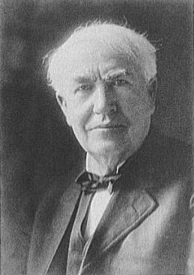
How electricity is mass produced?
  By a large generator
  Generator needs to spin
  Generator is connected to a turbine
  Turbine turns by steam, hydro or wind power
  Steam can be produced by fossil fuel or nuclear reaction
Thomas Edison
www.americaslibrary.gov/assets/jb/recon/
jb_recon_phongrph_2_e.jpg
Notes:
Can you name a device that we use everyday that has a generator?

Slide 4
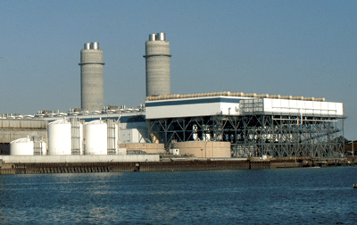
Steam Cycle Power Plants
Burn oil, coal, natural gas
(or wood, garbage!) or heat using nuclear energy
Heats water and turns it into steam
Steam pressure turns the turbine Turbine turns the generator
Generator makes electricity
Combustion Waste Gases sent to atmosphere
Ash waste transport to disposal site

Slide 5

Thermal Power Plants
NUCLEAR
REACTOR

Slide 6
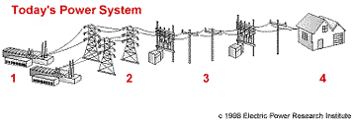
Generation and Transmission
Turbine and the generator rotate at usually 3600( Nuclear 1800) RPM
Generator make electricity
Generator voltage is usually between 18KV to 22KV
Step up transformer is used to increase the voltage to 110KV or higher (usually 345KV to 500KV) for transmission
http://www.southernco.com/alpower/storm/images/a_powersys.gif

Slide 7
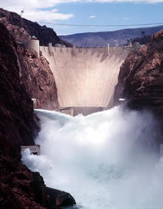
Hydro Plants
Dams are built to collect water
Water is collected in the reservoirs
Water is released through openings at the bottom of the reservoir
Water is routed through hydro turbines
Turbine turn the generator
Generator makes electricity
Hoover Dam
www.usbr.gov/lc/hooverdam/

Slide 8
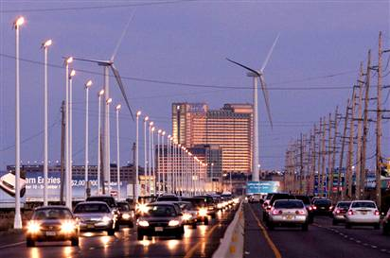
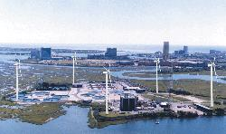
Wind Farms
Wind farms are becoming popular
Very long blades mounted on the top of a tower (100 feet up)
Usually several wind turbines are installed in a wind farm (can be over 100)
New large units in an ideal location should be able to produce up to 5MW of electricity
Limitations, no wind no power generation

Slide 9
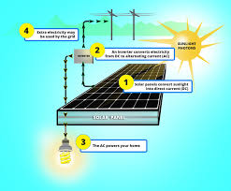
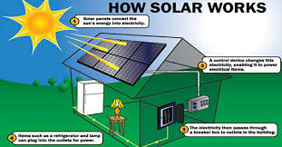
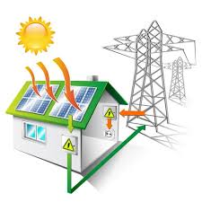
Solar Power
Electric Power Generation from Solar Power panels has been Increasing
A solar panel is used to take the energy from the speeding photons and turn that into an electrical current.
Solar panels are comprised of many smaller units called photovoltaic cells converting sunlight into electricity
Can only produce power during daylight and mainly when sun is shining
Efficiency depends(location, direction, exposure, amount of sunshine)

Slide 10
How does nuclear power plant work?
By splitting atoms in uranium
In process of splitting the atoms, heat is generated
The chain reaction creates heat
This results in heating/boiling the water, creating of steam
Steam is piped to a turbine, similar to fossil steam plants

Slide 11
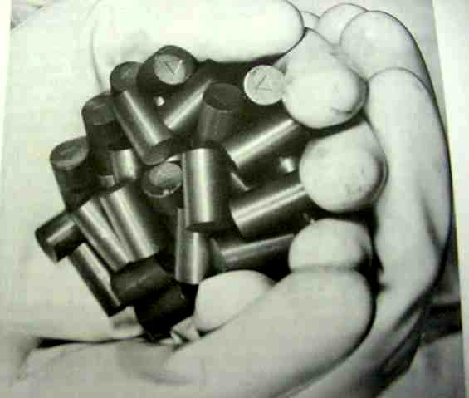
Fuel Pellets

Slide 12
A Note on Nuclear Reactor Design
The fuel is inside the Reactor Vessel
Reactor Vessel is surrounded with the primary containment
Fuel inside the vessel must be cooled by keeping it covered with water

Slide 13
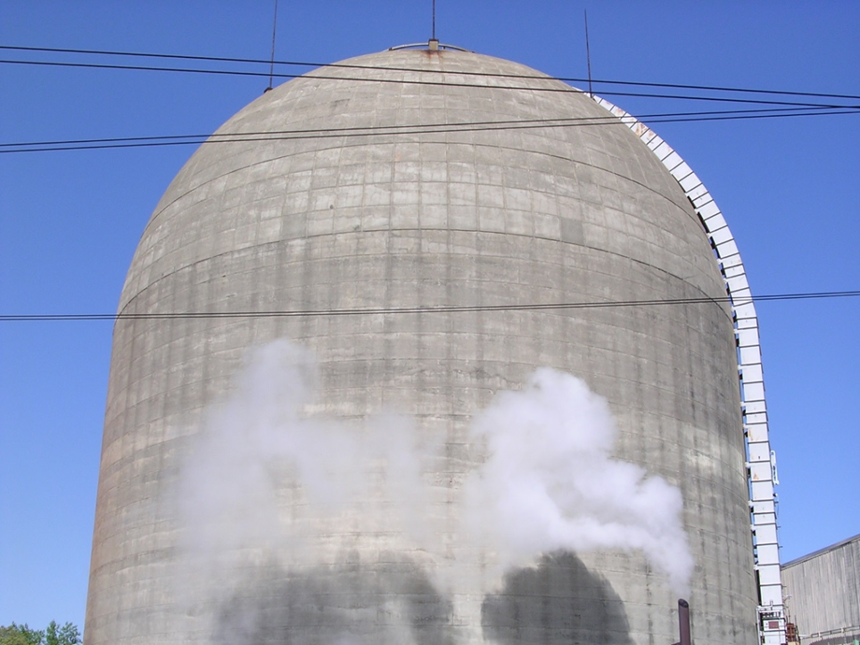
Plant Design
All units in the US are designed with a primary containment
Primary containment is one of the most important buildings in these plants
Primary containment is designed to contain radiation from escaping to outside environment if there is a major accident

Slide 14
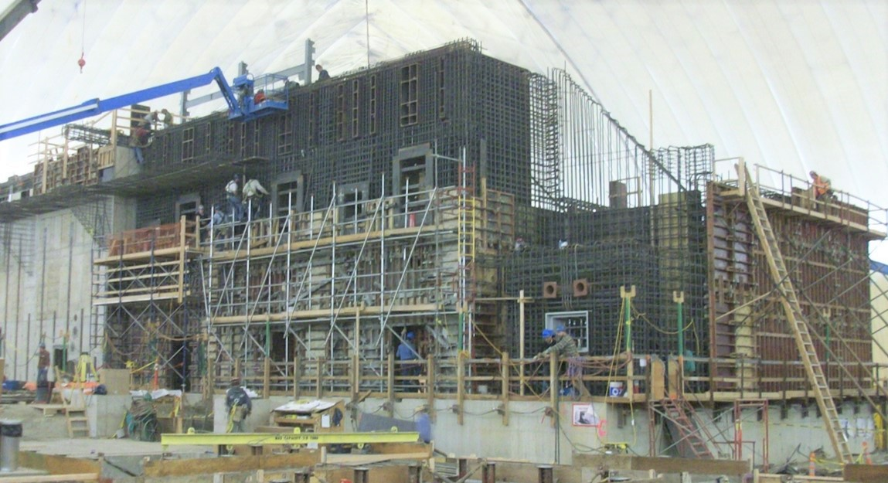
Nuclear Facility Structural Design
Structural design considers the following:
  Seismic, thermal, live, dead, static fluid and static soil demands
  Effects of dynamic Soil-Structure Interaction
  Effects of dynamic fluid-structure interaction in ultimate heat sink structures or spent fuel pools
Results in massive reinforced concrete and steel structures
Integrated Waste Treatment Unit at Idaho National Laboratory – Structural Design by Simpson Gumpertz & Heger

Slide 15
Pros & Cons of Nuclear Energy
Pros
Cons
Fuel availability
Reliability
Safety
Low environmental impact
Resistant to natural catastrophes
Long Operation life, 60 plus years
High employment
High initial cost
Long startup time
Regulatory treatment
Public misconceptions

Slide 16
Public Misconceptions
Misconception | Truth
Nuclear is NOT Safe | It is far safer than other power plants, industrial facilities transportation and even office workers
Nuclear Waste disposal is an unresolved problem. | There are no unresolved technical waste issues. It is purely a political issue. Currently spent fuel is stored on site in safe, guarded storage facilities which provide protection from an conceivable threat.
Nuclear accidents at Three Mile Island, Chernobyl and Fukushima produced significant radioactivity and killed people. | No public fatalities Gov. over reaction worse than event. Off site radiation none to minimally significant. Less than many industrial failures.
Nuclear power is too expensive | Nuclear is less expensive than solar and wind, coal and gas when evaluated on an equivalent, overall basis including pollution without subsidies.
Nuclear Power is NOT reliable | It is the most reliable form of power generation. After environmental catastrophes the nuclear plants have been fully operational.

Slide 17
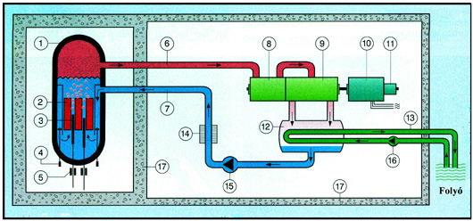
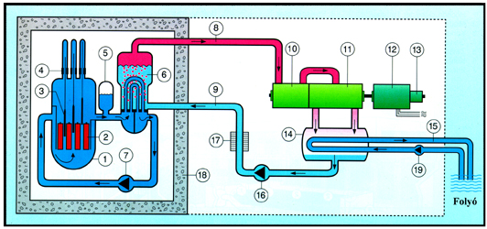
Current Nuclear Reactor Designs
Boiling Water Reactor
Pressurized Water Reactor

Slide 18
Advanced Nuclear Reactors
Most Operating Reactors are based on designs developed in the 1960-1970s.
Challenges to the current designs have sparked an interest in new, innovative designs.
Large Reactors, >1000MW
Small Reactors, 5MW to 300MW
Notes:
A incandescent light bulb uses 60W to 100W, a CFL or LED light bulb uses 4W to 15W power. A toaster uses about 1500W power.

Slide 19
Small Modular Reactors
  • Off site construction, Compact
  • Modular, smaller (150 MWe) per unit
  • Integrated steam generator
  • Fixed fuel utilization
  Passive safety systems
  strategy (5, 10, 20 year)

Slide 20
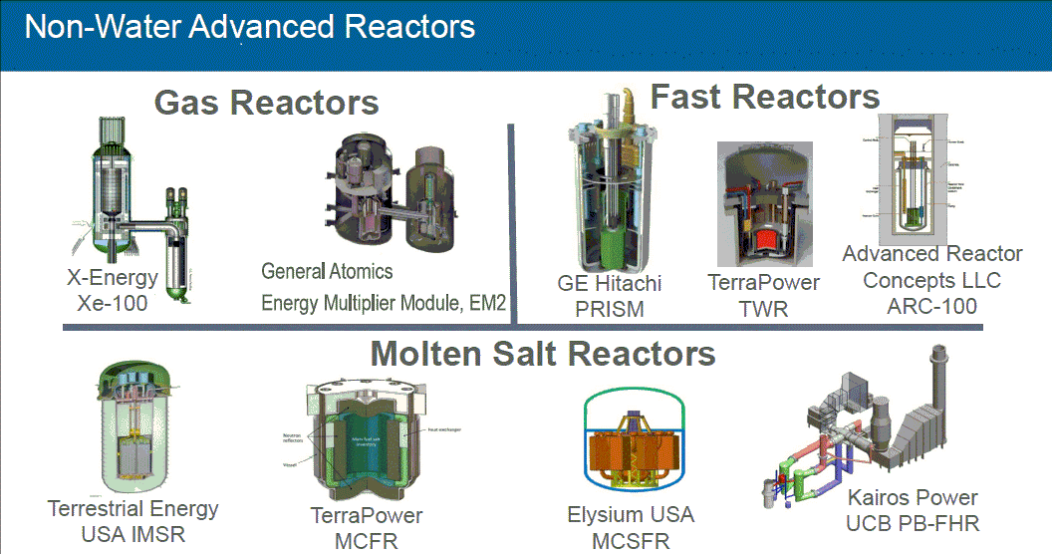

Slide 21
Top 15 Nuclear Generating Countries
2017, Billion kWh

Slide 22
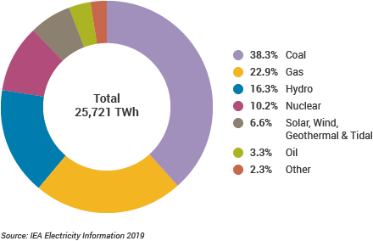
Countries that Rely on 20% or More on Electricity Generated by Nuclear Power
France 75%
Slovakia 52%
Belgium 51%
Ukraine 48%
Hungary 42%
Armenia 40%
Sweden 35%
Germany 27%
Romania 20%
Switzerland 38%
Slovenia 37%
Czech Rep. 33%
Bulgaria 33%
South Korea 35%
Japan 29%
Finland 33%
USA 18%
UK 19%

Slide 23
Note About Radiation Exposure
Radiation is measured in milliREM (REM stands for Roentgen Equivalent Man) in the U.S.
Radiation is measured in MilliSieverts in Europe. 1 MilliSieverts equals 100 MilliREMs (MR)
In U.S., the NRC’s guideline for a nuclear plant worker is 5,000 MR exposure per worker, per year.
During an emergency it can go up to 25,000 MRs per person
The U.S. NRC annual public limit is 100 MR/yr

Slide 24
Common Sources of Radiation
Cosmic radiation from outer space (26 to 96 MR/yr)
Food (Banana, Meat, Potatoes, etc.)
From water (40MR/yr)
Air travel (.5MR per hour in the Air)
Watching TV (1 MR/yr)
Medical Diagnostic
  Simple chest X-ray 10MR
  Chest CT scan 700MR

Slide 25
Nuclear Technology is used for:
  • Nuclear Power, Electricity Production
  • Nuclear Propulsion
  • Pharmaceuticals
  • Space Nuclear Power
  • Non-destructive testing
  • Food Preservation
  • Nuclear Medicine
  • Chemical Processing

Slide 26
Nuclear Engineers
What do they do? Research and develop the processes, instruments, and systems that use nuclear energy and radiation for beneficial applications
Where do they work? = typically in
offices, laboratories, hospitals, power plants and military
U.S. Bureau of Labor Statistics
2017 Median Annual Pay = $105,810 ($51/Hr)

Slide 27
Local Universities Offering Nuclear Engineering Program
UMAS Lowell (UML)
University of RI (URI)
Massachusetts Institute of Technology (MIT)
Worcester Polytechnic Institute (WPI)
Three Rivers Community College

Slide 28
Thank you for Listening
Hope this was educational
Questions?

